Slide 1

Spotify/Edamam Python Project
Lara Marina

Slide 2


Introduction to Project
What it does:
Integrates Spotify and Edamam APIs to recommend songs and recipes based on selected genre.
What I wanted to create:
A fun interactive app which combines music, food and vibes using individual user’s preferences fetched from their own Spotify libraries.
Notes:
My project integrates Spotify and Edamam APIs to recommend songs and recipes based on a selected genre.
I wanted to create a fun, interactive app that combines my great loves – music, food and vibes, using user preferences fetched from their own Spotify library.

Slide 3

My Code Structure
Uses Spotipy for Spotify API authentication/ data fetching. Integration of Edamam API Mapping genres to broad recipe themes/ cuisines using a dictionary.
How it works
Fetches songs from user’s Spotify library
If none match the selected genre, Spotify’s most recent popular songs are fetched
Displays both songs and recipes with clickable URLs to external links (Spotify, and recipe sites sourced by Edamam)

Slide 4
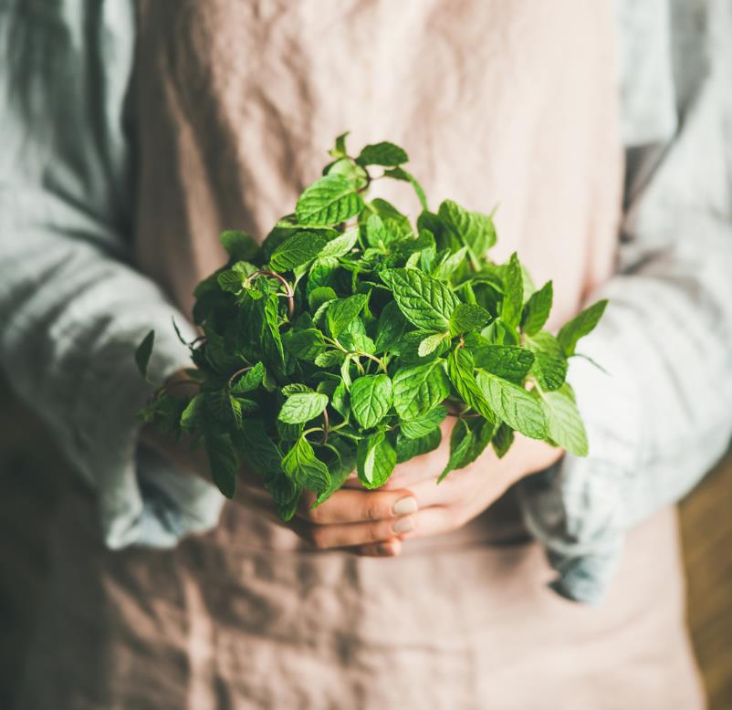
Challenges!
API integration struggles.
2. Working with .env files
3. Genre matching/ Linking 1 genre to multiple different cuisines
Notes:
- The first hurdle I met, early on, was trying to deal with authenticating the Spotify API correctly. Once I finally managed to get it working, I had an issue with Edamam (I think I was selecting the wrong plans, and I must’ve created about 84 original keys).
-Saving my sensitive information (ID and unique keys for authentication) securely in an .env file and ensuring it worked across my environment was a surprisingly big challenge
- Spotify tracks don’t have explicit genres, so had to map genres from the artists instead.

Slide 5
What I enjoyed..
The chance to be creative and do something outside of the prompt.
Seeing it all come together once the APIs were integrated
Learning via trial and error
Notes:
It was really fun deciding what musical genres should be linked to recipe themes, like jazz with appetisers and pop with desserts.
Once the APIs were successfully integrated, it was satisfying to see the app fetch personalised recommendations in real time.
Every debugging issue taught me so much about APIs and the language. I find the best way for me to learn is to get my hands dirty.

Slide 6

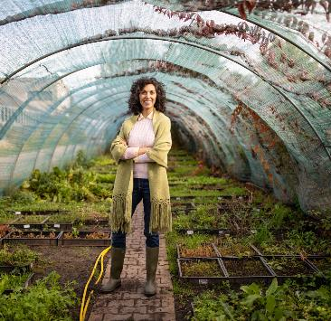
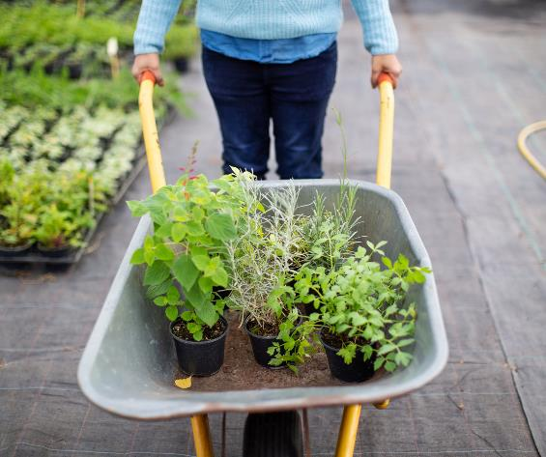
How I’d extend the project:
Save into a playlist
Refine the dictionary so that multiple cuisines can be listed under genres.
Find the top 10 most popular genres using the Spotify genre list https://gist.github.com/andytlr/4104c667a62d8145aa3a to refine the dic even more.
Better recipe filtering/ a refresh button that gives the user new random recipes.
Notes:
I’d have liked to enhance the genre-matching logic by leveraging Spotify playlists under the top 10 genres for more accuracy.
I would’ve loved to have added some kind of front-end interface using Flask to make the app more appealing to actually use
I would incorporate more detailed recipe filtering which could accommodate dietary restrictions or cuisine types.
I would’ve also figured out a way to save the output in an interactive way, as a spotify playlist and recipes in a PDF booklet.

